Slide 1
Population–Traffic Driven EV Charging Infrastructure Analysis using DBSCAN
RUTHIKA VALLABOJU
REGIS UNIVERSITY
DATA SCIENCE PRACTICUM 1

Slide 2
Introduction
EVs are becoming popular all over the U.S., and they make up close to 10% of new vehicle sales. However, the number of charging stations has not quite kept pace with demand. In fact, there was only one new public charging port added for every 29 new EVs added.
The actual demand is not reflected by the number of stations. Combining infrastructure, population, traffic data helps identify cities and guide charging expansion in the future.
To begin with the analysis, is to rank American cities by their underserved score. A score derived from EV charging availability, population, and traffic. The identified underserved cities are designated to multiple clusters using the DBSCAN unsupervised learning algorithm to identify geographic patterns, regional gaps, and priority areas for more charging stations and investments.

Slide 3
Datasets
Dataset | Coverage | Key Attributes
EV Charging Data(Source) | United States(~84,539 public and private charging stations) | Latitude, Longitude, Accessibility, Number of Charging Stations, Available Ports, Charger Type, Technical Specifications
Population Data (2025)(Source) | U.S. Cities(19483 records) | City Name, State, Population Estimate (2025)
Traffic Data (TomTom Traffic Index)(Source) | 91 U.S. Cities | Congestion Level (%), Rush-Hour Time Loss, Traffic Indicators

Slide 4
Data Cleaning
Dataset | Processing Performed | Output
EV Charging Stations | Filtered only public stations; Removed duplicates; handled missing values; standardized city names & ZIP codes; validated locations | Cleaned EV charging infrastructure dataset(78954 rows)
Population Data (2025) | Checked completeness; standardized city identifiers; aligned geographic units with charging station data | City-level population dataset(No rows removed)
Traffic Congestion Data | Cleaned missing/inconsistent entries; converted congestion indicators to numerical format; standardized location identifiers | Structured traffic congestion dataset
Data Integration | Merged EV charging and population datasets by city; integrated traffic data; verified merge accuracy and resolved inconsistencies | Unified dataset for EV infrastructure, population demand, and traffic analysis (78954 rows )

Slide 5
Feature Engineering
We take raw demographic and traffic data and level it to demand indicators to assess the sufficiency of EVSE in cities.
Population per Station: Measures charging infrastructure availability per resident.
Demand Pressure: Captures potential charging demand using a log-transformed population-to-station ratio.
Congestion Pressure: Represents traffic demand relative to available charging stations.
Underservice Score: Combines demand and congestion pressures to identify underserved cities.

Slide 6
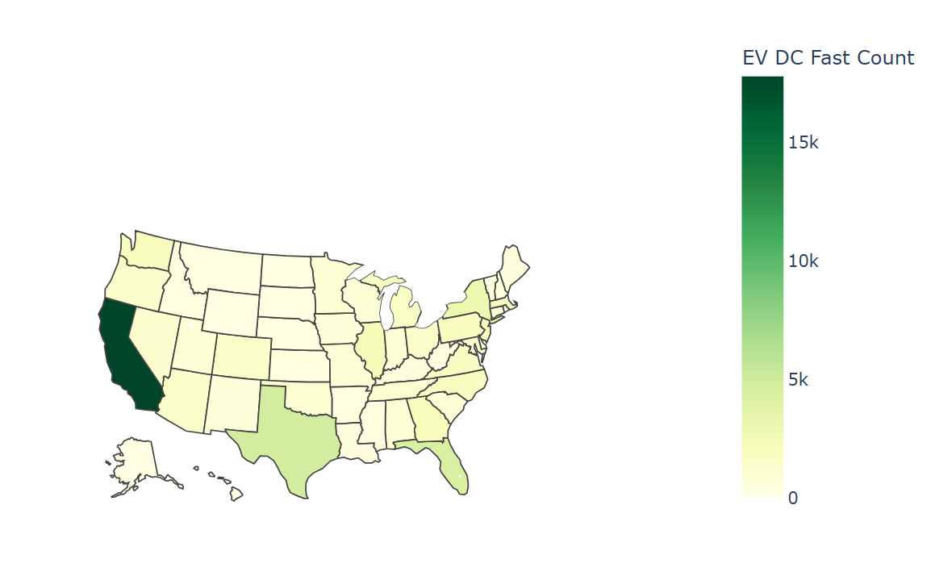
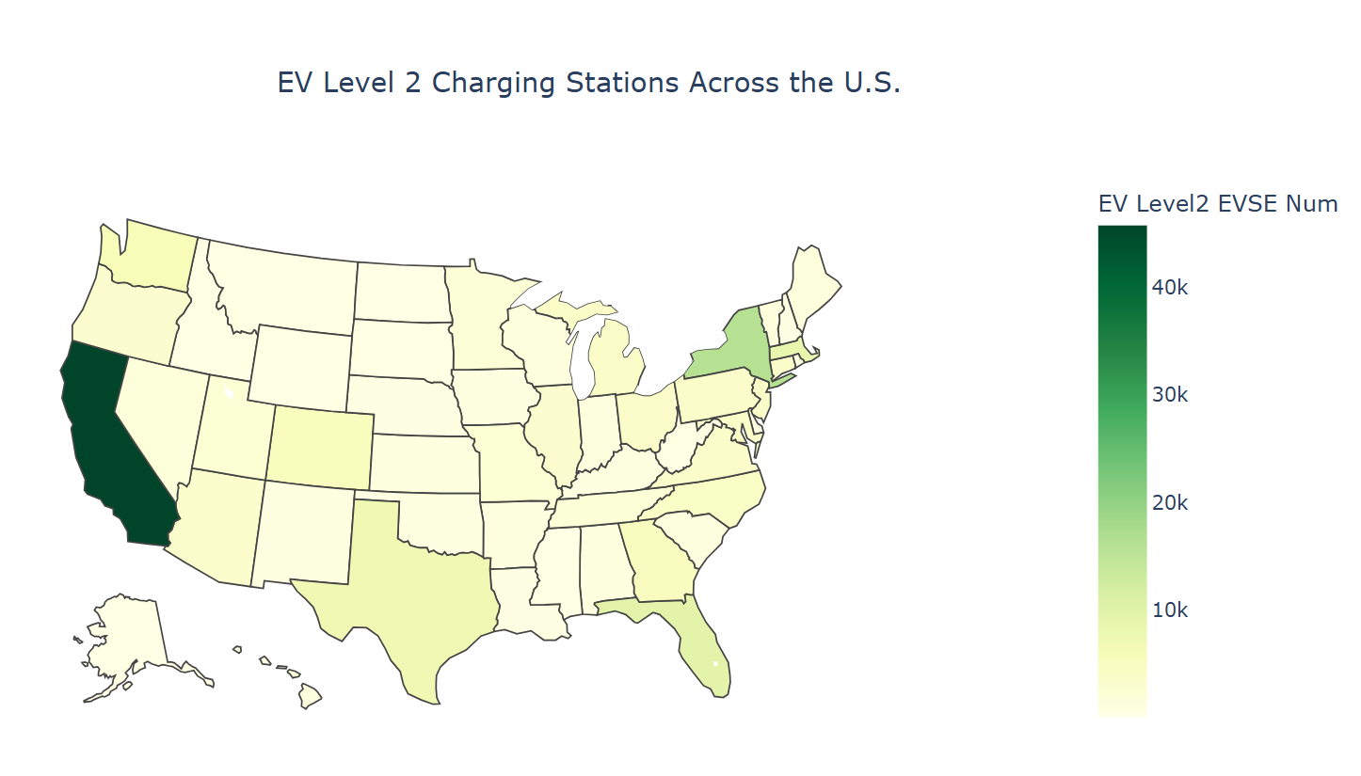
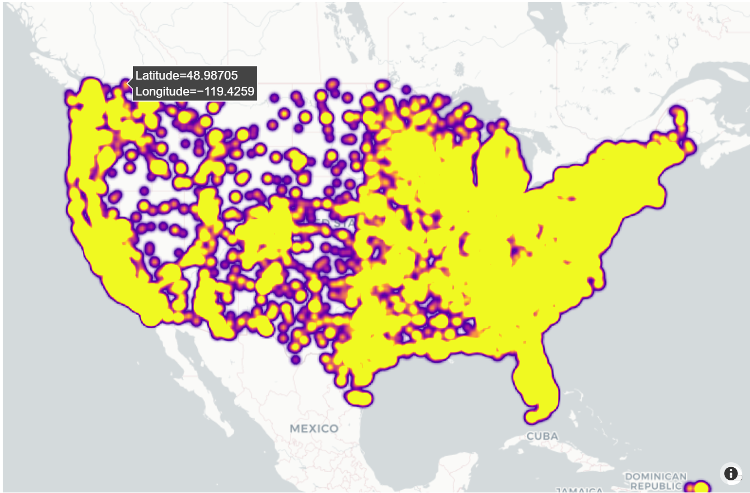
Exploratory Data Analysis
Many of the fast-charging infrastructure is concentrated in California detailed in the report.
The deployment of level 2 charging also follows a similar pattern, but has more regional differences.
Stations are clustered around major population centers, while many regions have lower coverage.
Charging infrastructure is unevenly distributed across the U.S. Geospatial clustering reveals regional patterns and infrastructure gap hotspots that may not be apparent from city-level analysis alone.

Slide 7
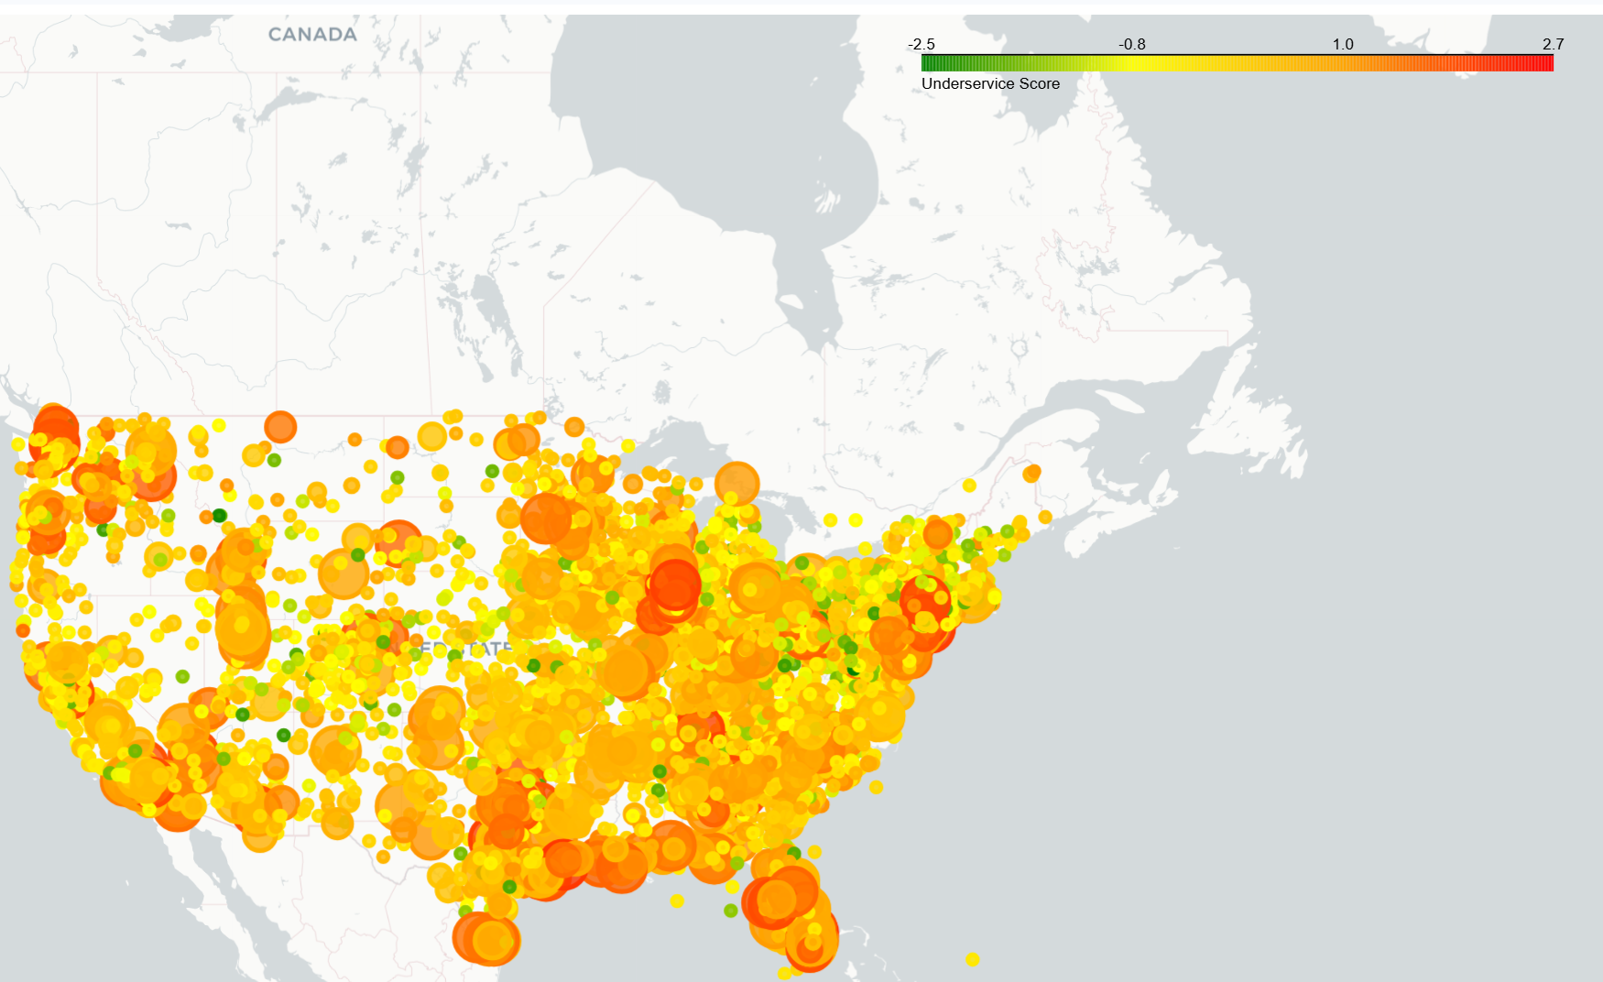
Ranking Underserved Cities
Cities were ranked using an underserved score.
EV charging shortages were concentrated in regional clusters rather than isolated cities.
Prioritize regional infrastructure investments to address concentrated charging gaps and improve EV accessibility.

Slide 8
Model Selection
DBSCAN was selected because underserved regions are unknown beforehand, may form irregular geographic patterns, and can include isolated cities.
Using the underservice ranking along with DBSCAN will provide additional information on concentrations of underserved cities, help identify gaps in infrastructure, help distinguish isolated geographic areas from the larger hotspots, and ultimately allow for more targeted installations of charging stations.

Slide 9
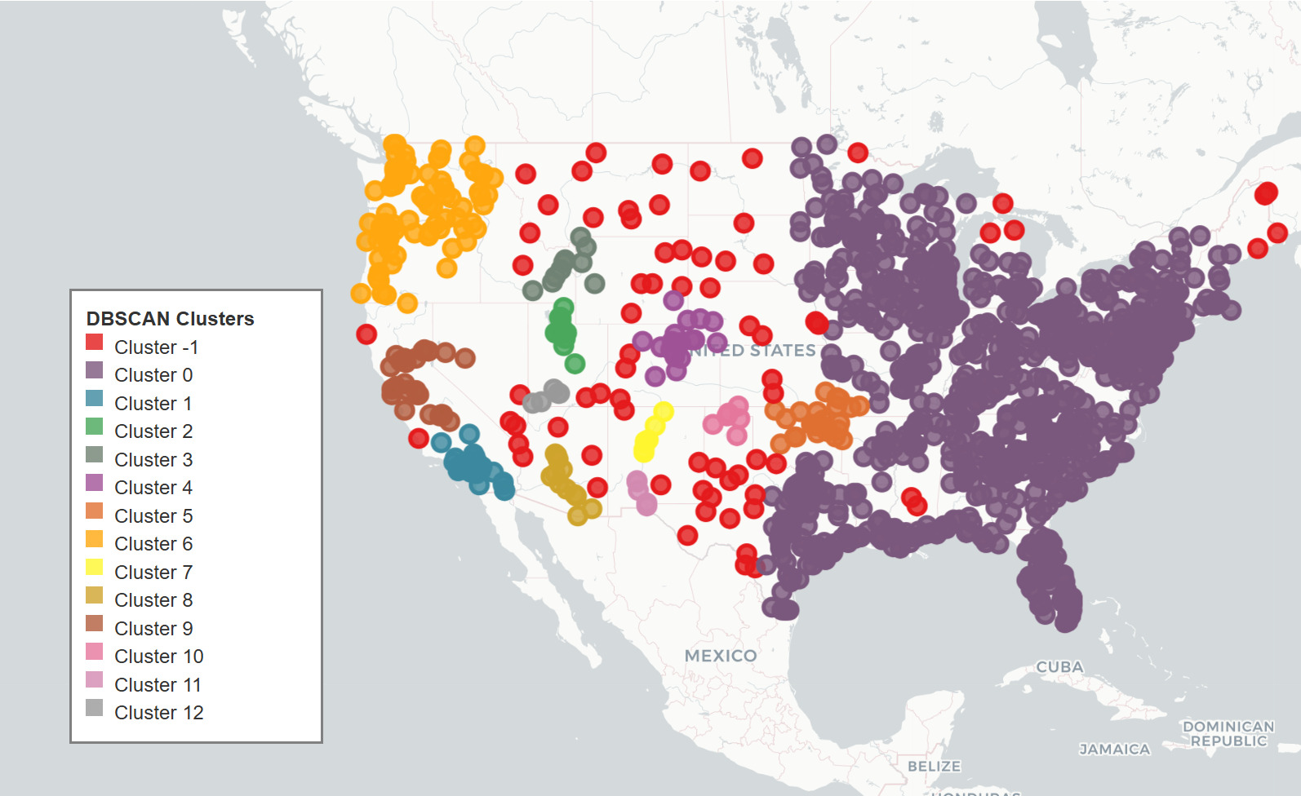
DBSCAN Clustering
DBSCAN found a total of 13(ignoring the outliers) of the areas that have been identified as underserved.
The largest of the clusters were made up of several neighboring states, reflecting on a regional need for improvements related to infrastructure.
The smaller clusters show localized hotspots of areas that are also underserved.

Slide 10
Working of DBSCAN
Eps (i.e., Complete Runtime Distance) is set to 0.02 rad or approximately 127 km.
Cities located within 127 km of each other are also considered as neighbours.
An underserved city can be classified as a member of a cluster if it is geographically located within 5 neighbouring underserved cities.
The Density-Based Method has identified County Regions with concentrated levels of infrastructural deficits. Clusters can extend up to, and beyond 127 km, by joining and adding together neighbouring cities.

Slide 11
Model Tuning
DBSCAN was tuned by varying the eps (neighborhood distance) parameter
A grid search was performed to evaluate clustering behavior across different eps values.
The best balance was achieved at eps ≈ 0.02, resulting in 13 clusters and 73 noise points.
eps | Clusters | Noise
0.01 | 46 | 414
0.012 | 38 | 288
0.015 | 25 | 148
0.018 | 18 | 91
0.02 | 13 | 73

Slide 12
Model Evaluation
DBSCAN identified 13 distinct underserved regional clusters.
Only 4.93% of cities were classified as noise (unclustered).
95.07% of cities were grouped into clusters.
The results indicate strong clustering coverage and meaningful hotspot identification
Metric | Value
No. of clusters | 13
Noise percentage | 4.93 %
Coverage percentage | 95.07 %
Silhouette score | 0.178

Slide 13
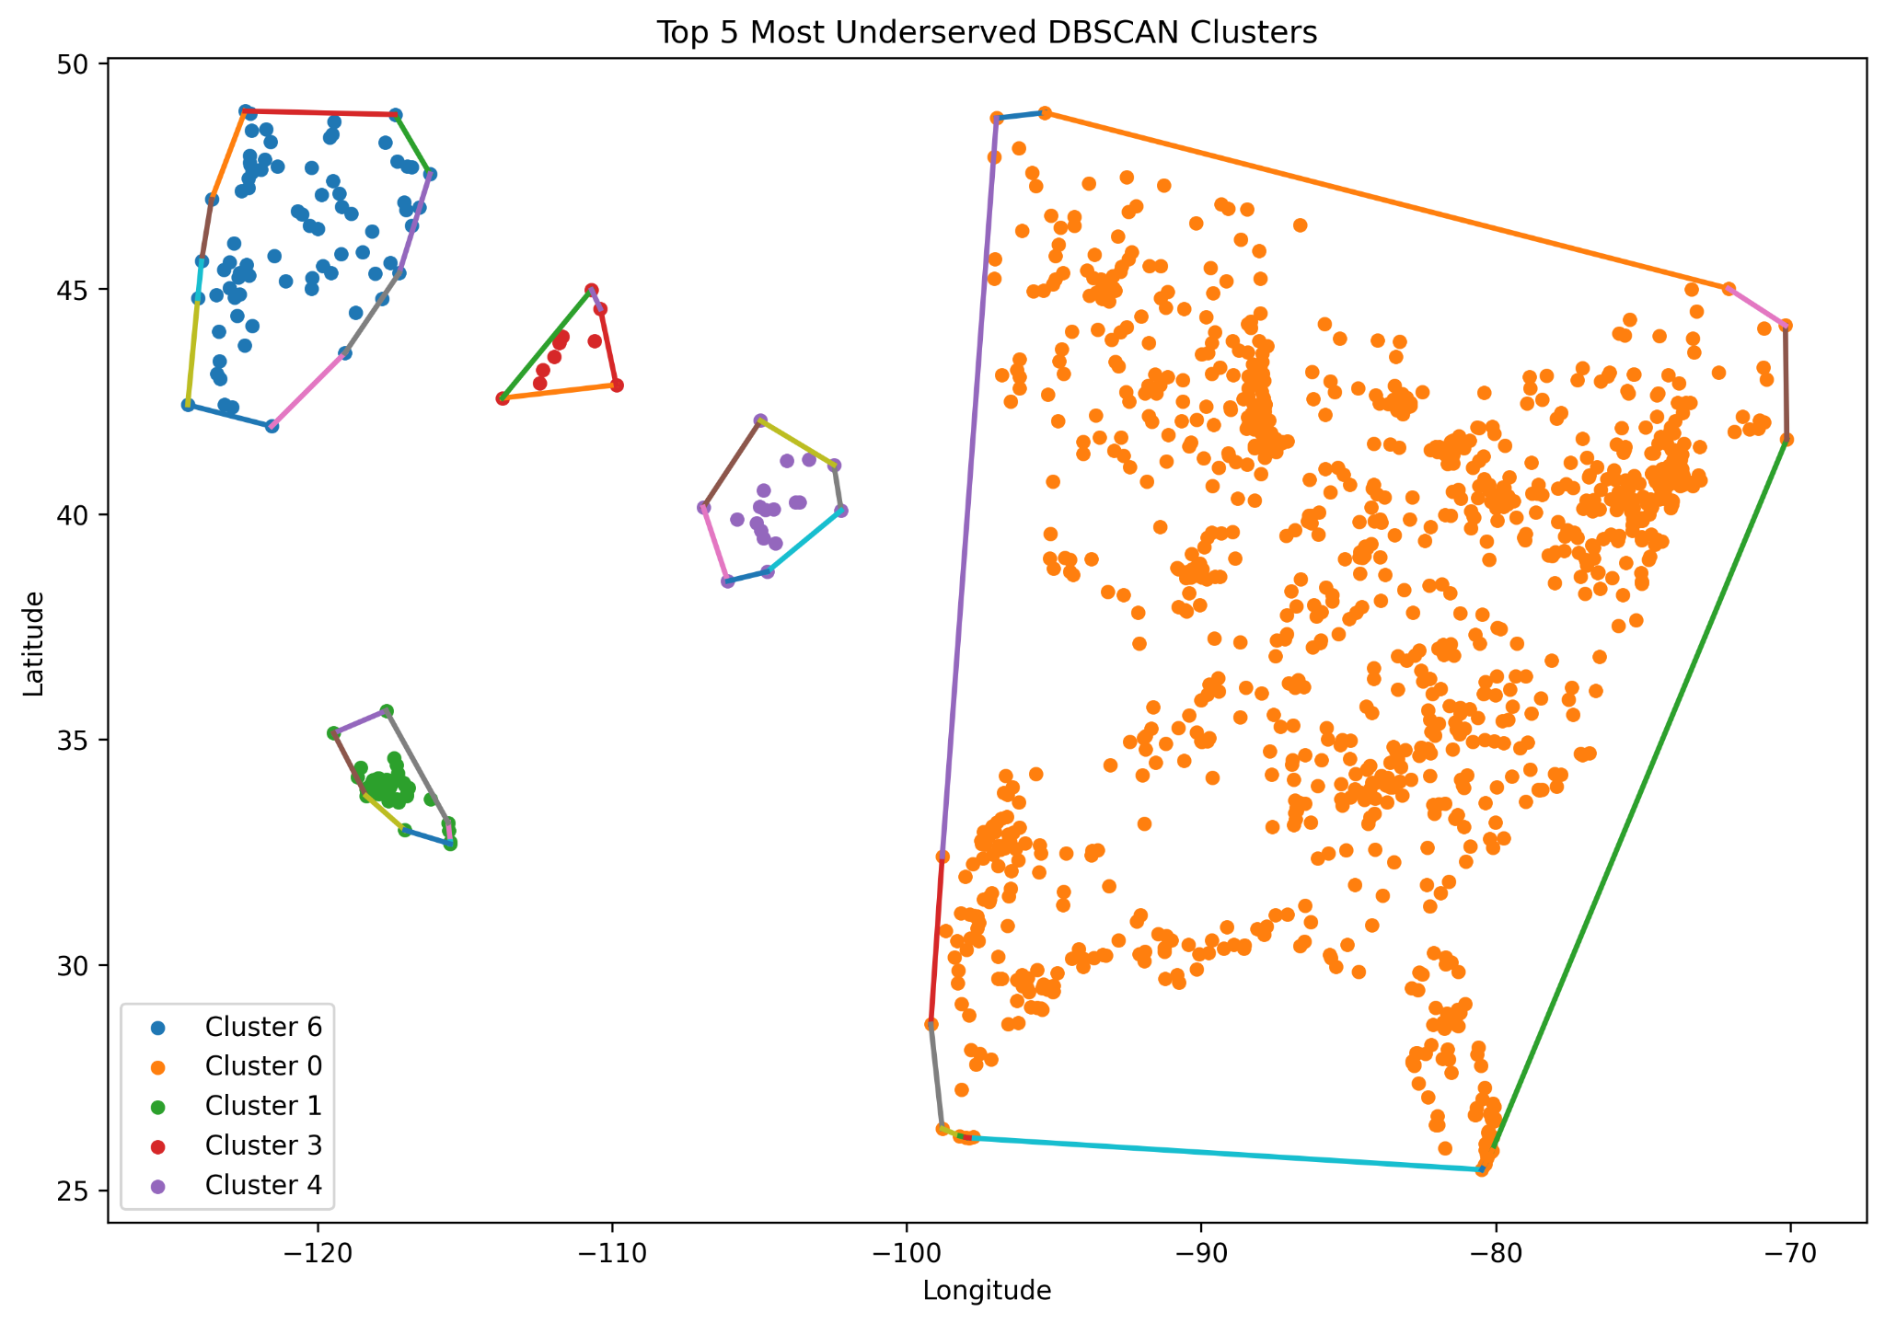
Top underserved clusters
Selected the 5 most underserved clusters based on low station density.
Compared charging infrastructure against population and traffic demand
Identified priority regions with significant infrastructure gaps.

Slide 14
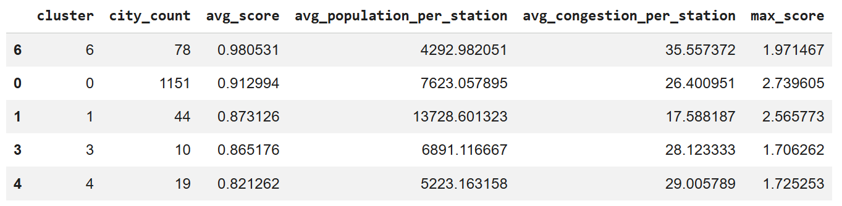
Cluster Profile
Cluster-based analysis of the distribution network based on demand, congestion and infrastructure performance has been completed.
Clusters 1, 3, and 4 with high demand and congestion levels are the most appropriate locations for capital investment in your infrastructure.

Slide 15
Overall Findings
Underservice scoring has effectively identified cities that have inadequate charging infrastructure with respect to population and traffic congestion.
The cities with the highest underserved ratings are found within specific geographical areas.
Using the DBSCAN clustering method, we identified the locations with distinct underserved clusters with infrastructure deficiencies.
Additionally, some underserved clusters are present across several different neighbouring cities; thus, there are deficiencies related to charging at the regional level versus the city level.
This information allows for both ranking (based on underserved) and spatial clustering to better guide future electric vehicle charging investments.

Slide 16
Conclusion
While the current framework provides meaningful insights, it can be further strengthened by incorporating additional demographic and contextual variables such as income levels, vehicle ownership, urban density, and policy differences, as well as by integrating temporal analysis to better understand how infrastructure needs evolve over time.
Overall, the study provides a scalable and interpretable foundation for evidence-based planning of EV infrastructure with strong potential for future expansion.

